Slide 1
Walt Disney World
A technical presentation of data preparation and analysis by Mandy Sachs

Slide 2
PREFACE
01
NULL VALUES
02
TABLE OF CONTENTS
CLEANING DATA
03
DATA EXPLORATION
04
Introduction and Background
Addressing nulls in the dataset
Cleaning steps and how items were addressed
Data exploration and Visualizations

Slide 3
01
Preface
Intro and Background about my selected dataset

Slide 4
Intro and Background
Found on Google Dataset Search Engine
Origin on Data.world
Dataset originally used for hypothetical rides to be compared to current rides
Dataset is from 2018
My interest in the dataset
Avid theme park attendee
Annual Passholder at Walt Disney World
Categories were already separated
out from its written out list of features
Theoretically clean, but good to always check it ourselves
df.shape
(46, 28)
Small dataset

Slide 5
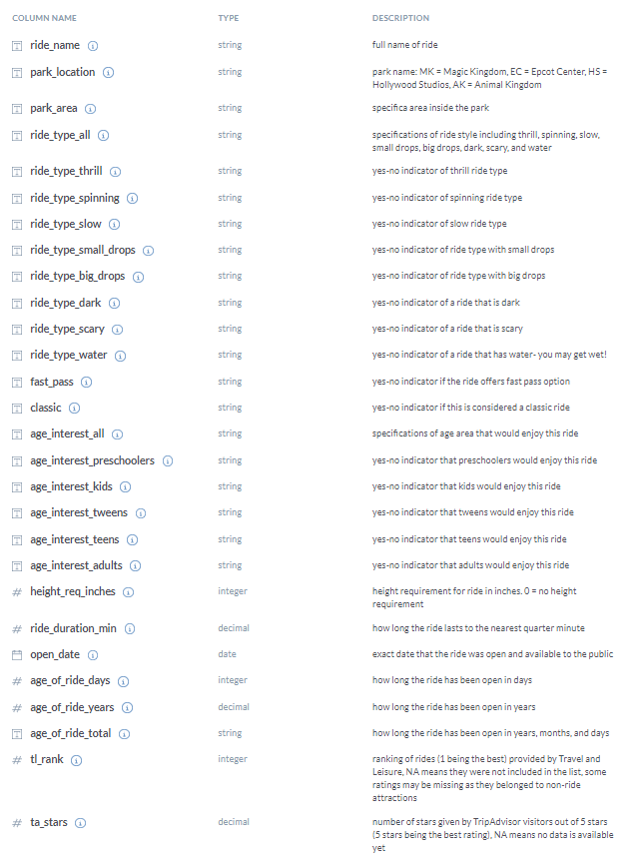
Data
Dictionary

Slide 6
02
Null Values
Addressing null values (NaNs)

Slide 7
DEALING WITH THE 4 NULLS
df[df['TA_Stars'].isna()]
Shows that in “TA_Stars”:
“Alien Swirling Saucers” and “Slinky Dog Dash” are the NaNs
df[df['TL_rank'].isna()]
Nulls in this column are:
“Main Street Vehicles” and “Wildlife Express Train”
2
4
1
3
5
df.isnull().sum() shows there are nulls in “TL_rank” and “TA_Stars”
Fill NaNs in “TA_Stars” as appropriate
Dropped “‘Main Street Vehicles” and “Wildlife Express Train” rows from the dataset

Slide 8
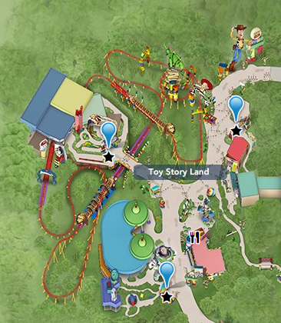
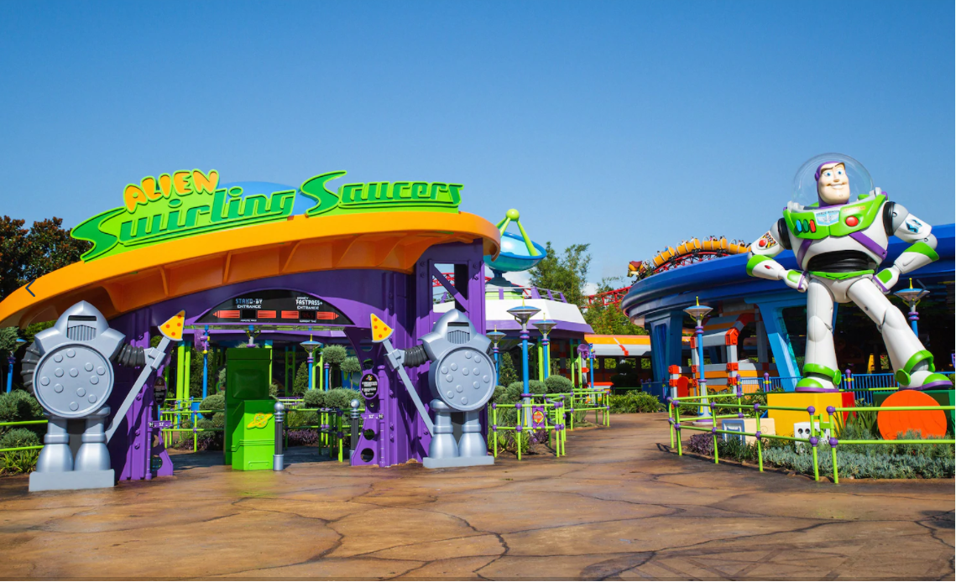
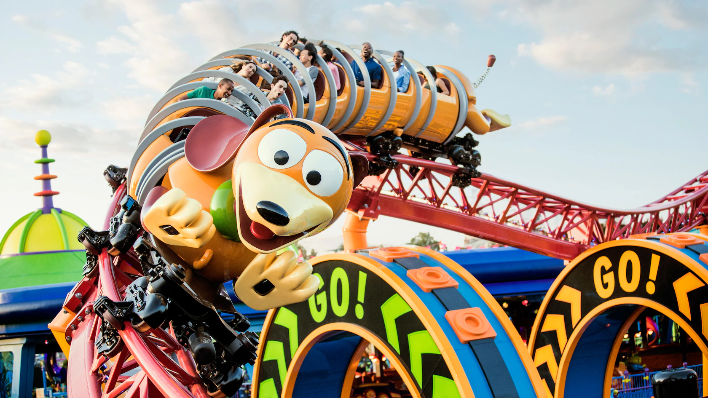
FILLING OUR TA_Stars NULLS
FILLING NULLS
ALIEN SWIRLING SAUCERS
SLINKY DOG DASH
Images obtained from Walt Disney World’s website
Research based approach
Travel Advisor now has a rating for this ride
4.5 star ride
Needed an if/else type of format to change these two NaNs
df['TA_Stars'] =
np.where(df['Ride_name'] == 'Alien Swirling Saucers',
df['TA_Stars'].fillna(4.0),
df['TA_Stars'].fillna(4.5))
Individually checked outputs to verify change:
df[df[‘Ride_name’] == ‘Alien Swirling Saucers’]
df[df[‘Ride_name’] == ‘Slinky Dog Dash’]
ride_type_all feature was “spinning.”
I created a df for spinning rides to analyze:
spinning_rides = df[df['Ride_type_spinning']==[Yes']
spinning_rides.describe( ) to find the mean star rating
Average is 4.136364

Slide 9
03
Cleaning Data
Explanation of the cleaning steps required and a brief explanation of how I addressed them in my dataset

Slide 10
DATA CLEANING STEPS
NULLS
DUPLICATES
DTYPES
SYNTAX
BINARY
NUMERICALS
Dealt with and explained in previous section
df.duplicated().any()
False
Additional tackling of “duplicate” columns
DTYPE for TL_Rank was a float rather than a integer.
Found a singular typo:
“thirll small drops” in the “Ride_type_all” column
All “Yes” and “No” in categorical columns, changed to 1s and 0s
mymap = {'No':0, 'Yes':1}
df = df.applymap(lambda s: mymap.get(s) if s in mymap else s
No outliers or incorrect numbers in the columns that are integer or float dtypes.

Slide 11
04
Data Exploration
Data Exploration with code and visuals to further understand the dataset

Slide 12
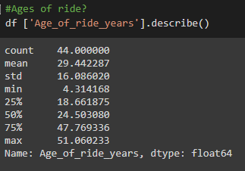
EXPLORATION W/ CODE
HOW OLD ARE THE RIDES?

Slide 13
EXPLORATION W/ CODE
SORT_VALUES
Created a table to look at the ranks of the rides, next to their star ratings.
ranks = df[[‘Ride_name’, ‘TL_rank’, ‘TA_Stars’]].sort_values(‘TL_rank’)
By outputting “ranks”, I am given a dataframe with columns of the names of the rides, their rank on Travel & Leisure, and their Travel Advisors Star rating, but in order of their rank.
#1 Ranked Ride was ‘Expedition Everest’ with a 5.0 star rating
#53 Ranked Ride (last) was ‘Journey Into Imagination with Figment’ with a 3.0 star rating

Slide 14
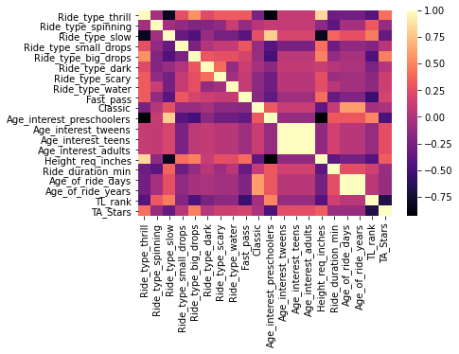
DATA VISUALIZATIONS
Heatmap Correlations
Age Related Correlations
Positive Correlations
1.0 or visually equivalent:
all age interests
Ride_type_slow & preschoolers
Negative Correlations
Height requirements & preschoolers
Thrill rides & preschoolers
TA_Stars
Negative Correlation
Preschoolers

Slide 15
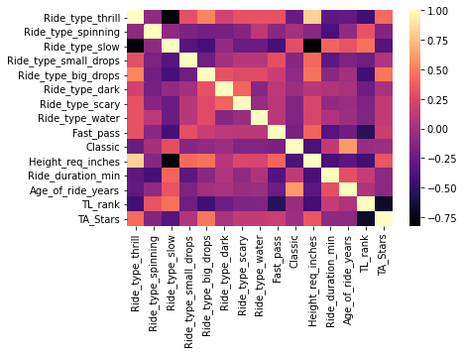
DATA VISUALIZATIONS
Heatmap Correlations
Positive Correlations
High:
Height & Thrill rides
Moderate:
Thrill rides & Big Drops
Classic & Age of Ride
Negative Correlations
Height & slow rides
Fast Pass & Slow rides
Thrill rides & slow rides
TA_Stars
Positive
Thrill Rides
Big Drops
Negative
TL_rank
Slow rides

Slide 16
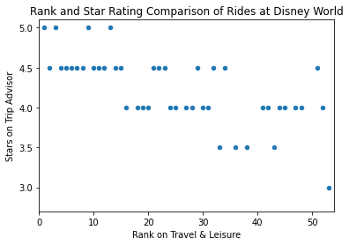
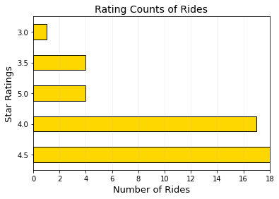
DATA VISUALIZATIONS
COMPARING RANK AND STARS
HOW MANY RIDES HAVE EACH RATING?
Star rating and rank are slightly independent of each other, with a negative trend
Most are at 4.5 and 4.0, only one is at 3.0 stars
Replicates groupby code (next slide), without the names of the rides

Slide 17
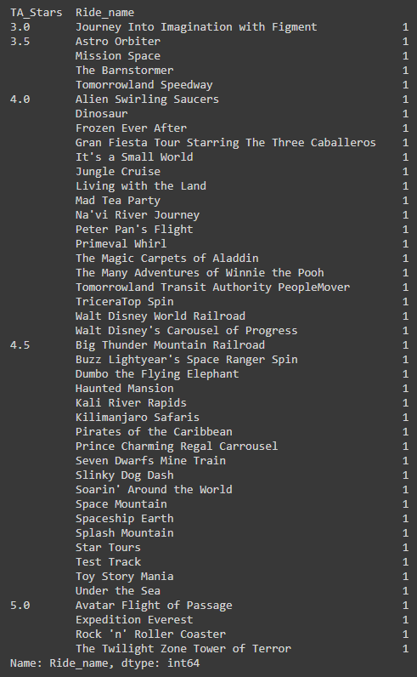
EXPLORATION W/ CODE
GROUPBY
Input
Output
sv = df.groupby(['TA_Stars'])['Ride_name'].value_counts()
sv

Slide 18
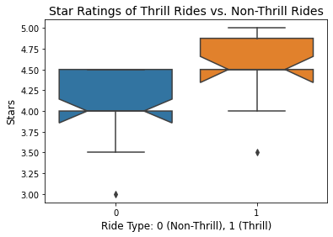
DATA VISUALIZATIONS
Boxplot
Distributions
Thrill rides have more stars overall than non-thrill rides
The 25% and 50% are the same for both categories
Non-thrill rides do not have any 5.0 star attractions
Each have one outlier

Slide 19
POST DATA EXPLORATION
MINI DATA FRAME
SUPPORTED GOAL
Created a sub data frame dropping all age_interest type columns, to potentially use later
Create a supervised model to predict what features determine a well rated/high star attraction

Slide 20
THANKS
Look at all of my code on my colab notebook.
The rest of my project will be displayed on my Github.

